Slide 1




FIRMBACKBONE
Open-science principles and restricted data
Peter Gerbrands, Wolter Hassink,
Daniel Oberski, Rutger Schilpzand,
Arjen van Witteloostuijn
January 15, 2025
Attracting researchers while adhering to FAIR
Notes:
I would like to talk about how to market the data, but at the same time make datasets reliable and more impactful. While doing this you also increase the reliability of your data, and attract feedback from users. In the end the aim is for researchers to get reliable experience of the data

Slide 2
Why FAIR?
[Findable] data constellations used for a project can be earmarked
  meta-data present in the ODISSEI meta-data portal
  we are still looking for best practice (DOI, citation of data in brief article)
[Accessible] work at a university department with ODISSEI membership
  access procedure is described in the meta-data (subject to change)
[Interoperable] ensures relative durational robustness
  open-source data format (csv and parquet)
  computations via R (in the future also Python)
Notes:
FAIR is a way to provide data reliably, both in terms of a long time-span and high quality data.
Why would anyone choose for FAIR-ing their dataset to begin with? The acronym may be known, but in this presentation Iwill show you what it means to try to adhere to FAIR data.
First the acronym.
Findable -> the data can sometimes be found on a website for a decade which stops working after a while. On top of that data is often placed somewhere without the thought of what happens when some error is found. Most providers of data – including researchers who want to share their data – are aware of this problem and publish their data on data repositories.
Once it is there, how should other researchers cite your data? From the point of recognition and rewards, the effort that has gone into publishing your data should be recognised. Does a DOI provide abundant recognition or should we request researchers to cite a data in brief article?
Accessible -> In our case we have limited scope for who can have access. In a perfect world we would like to provide anyone access. However, due to the valuable nature of the data, we cannot. In fact we have to restrict access quite a lot. .. ODISSEI… the reason we do this is because being part of the ODISSEI umbrella means there is judicial recourse that protects against data infringements. Without such a clause we would need to vet every person individually. And not just us, but the head of the economics department, or maybe even higher up the food chain.
How to obtain access will be clearly described within the documentation present in the ODISSEI data portal
Interoperable -> This requirement also attests to the longevity of the data. Tomorrow other datatypes may be the ‘hype’ compared to today. We aim to find a balance here.
On the one hand we would like to use highly reliable formats, on the other hand we like for users to be able to work with it.
As FBB takes place in a closed environment the interoperability is also related to the analysis software. Researchers have no other choices than we can offer. For now we only offer R, in the future this will be extended to Python.

Slide 3
Why FAIR?
[Reusable]
 |  |  |  | Methods in follow-up study versus methods reported in original
 | Sampling distribution for parameter estimates | Sufficient conditions for discrepancy | Types | Same speci-fication | Same population | Same sample | Examples | FBB
Replication | Same | Random chance, error, or fraud | Verification | Yes | Yes | Yes | Fix faulty measurement, code, data set | Same sample (versioning)
 |  |  | Reproduction | Yes | Yes | No | Remedy sampling error, low power | Same specification (syntax can be saved on server)
Robustness | Different | Sampling distribution has changed | Reanalysis | No | Yes | Yes/No | Alter specification, recode variables | Syntax and data can be added to different research projects
 |  |  | Extension | Yes | No | No | Alter place or time; drop outliers | Thorough longitudinal setup required (matching through time)
Table 1: Clemens, 2017:J.Econ.Surv.
Notes:
Interesting is the reusability aspect of the data.
These days replication studies are garnering more attention. These are important for any field to remain self-correcting. For data providers the aspects of reusability of data are highly important, as they will occur very often. We have a particular dataset which researchers use over and over. It is important to be aware whether all tools are present to conduct replication studies or check slightly different questions.
From the researcher perspective there are two different types of studies that one can do.
Replication, meaning you use the same sampling distribution for whatever your research subject is.
You may want to verify the data,…, in that case it is highly important that we provide the same data. A type of versioning. That is why we will use a different DOI for avery new version we make available.
You may want to reproduce the data for a newer larger sample, or simply conduct the analysis on churchmunicipalities instead of private companies. In that case it is important that we provide a service to store syntaxes on the server for reuse.
Robustness, this is our bread and butter. Most researchers will at best answer slightly different RQs, for this it is again imerative that the original data is available and that syntaxes can be previously used loaded onto the environment
Extensions will be interesting as the dataset is organically growing, so expanding. More data will be added with every year. For this it means that

Slide 4
The challenge of FAIRness
[FAIR] does not mean accessible under all circumstances
[FBB] has access limitations
  interceding with FAIR?
  assessment by who?
Notes:
Due to our restricted access can we not adhere to the FAIR principles?
Yes we can, but how do they really intercede with the FAIR principles and who assess that we yes/no adhere to these specifications?

Slide 5
FIRMBACKBONE AVG/GDPR
Privacy issues
[private persons] may not be identifiable in data CBS wet art. 37 sect. 3
[firms] should not be identifiable, however, only if substantive reasons exist
[both] not identifiable in FBB
Accessible data
[source] ingested and scraped data only accessible to a few [currently one] verified data developers
[pseudonymizing] names and identification numbers are removed from ingested and web-scraped data,
[postal codes] are aggregated to 4-digit level
[separation] source data kept on separate servers, researchers can only access curated data through SANE
[SANE] data protected against downloading and individual identification
[access] a SURF-account is necessary for SANE, the department needs to be ODISSEI-partner for judicial recourse
Emphasizing privacy
[Data providers] we are using their data, so extra care required
[DMP] the Data Management Plan is accepted by UU Research Data Management and Privacy Officer and VU Research Data Stewards and Privacy Champion
Notes:
Before answering that I would like to explain why we need to limit access.

Slide 6
The challenge of FAIRness
[FAIR] does not mean accessible under all circumstances
[FBB] has access limitations
  interceding with FAIR?
  assessment by who?
FAIR Implementation Plan
  [tool] : a questionaire leading to discussion
  [goal] : achieving higher FAIRness
  [aim] : support ease of use and increase robustness of data

Slide 7
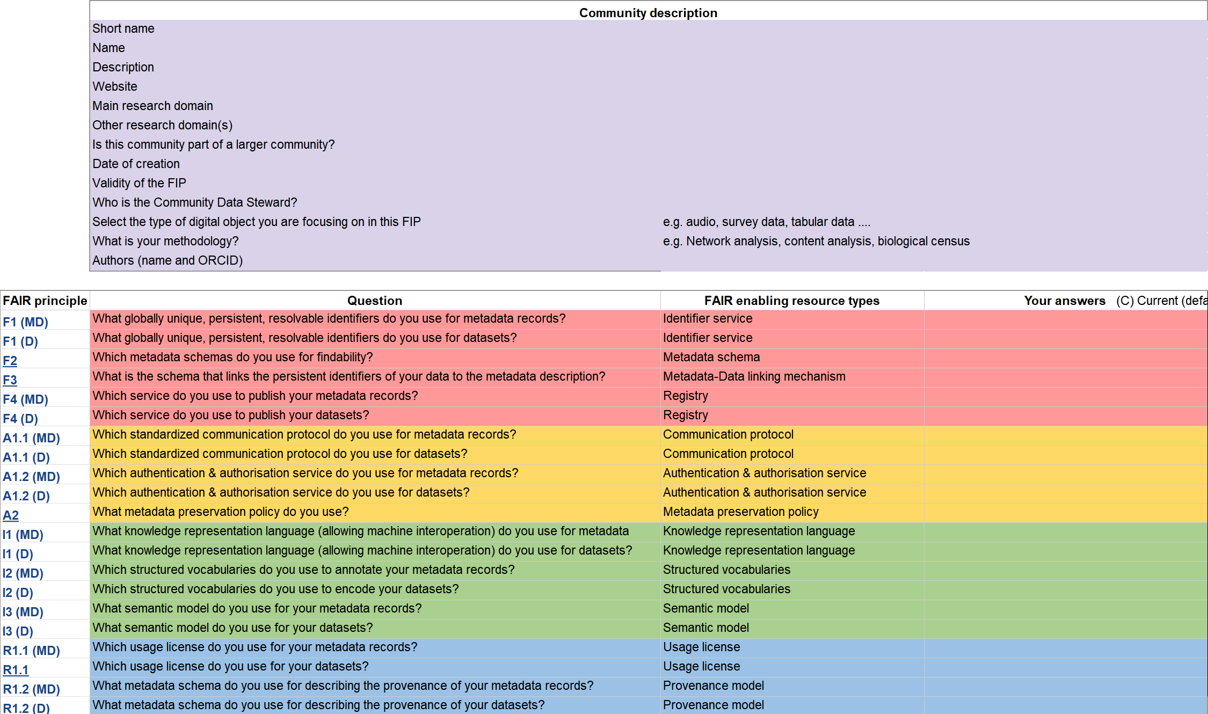
FAIR Implementation Plan - tool

Slide 8
FAIR Implementation Plan - goal
[Access] continuous, reliable and robust
[Data structure] designed to be cumulative and backward compatible
[Data storage] long-term, clearly labelled, robust datatype
[Meta data] informative, structured, machine readable

Slide 9
FAIR Implementation Plan - aim
[User] central to any implementation
[Data knowledge <[alternative term]]
  visibility
  understanding (without access to the data)

Slide 10
Questions?
Thank you for your attendance…

