Slide 1
Sustainability Analysis Platform:
Using NLP and a Secure Data Pipeline (FirmBackbone)
Hadi Mohammadi
Utrecht University
Jan 15, 2025

Slide 2
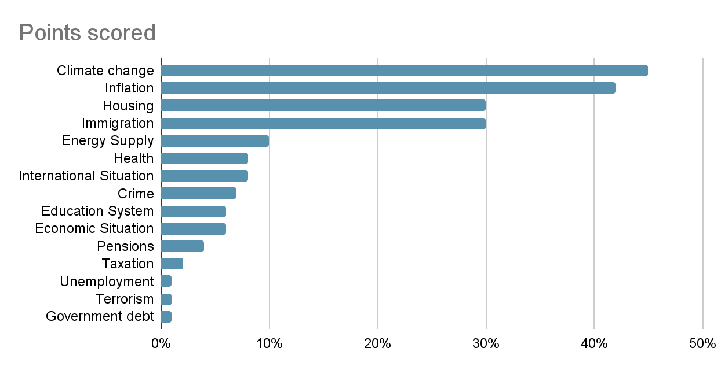
Problem
What are the most important issues facing the Netherlands at the moment?
Climate change is a top concern among all generations in the Netherlands. A 2018 poll in which respondents were asked whether they consider global warming problematic or not, over two thirds of respondents in all age groups stated to consider it (very) problematic. Concern was highest among those older than 55 years (78 percent), but among the participants younger than 35 years 67 percent also stated to consider climate change a problem.
https://www.statista.com/statistics/547685/public-opinion-of-important-issues-facing-the-netherlands/

Slide 3
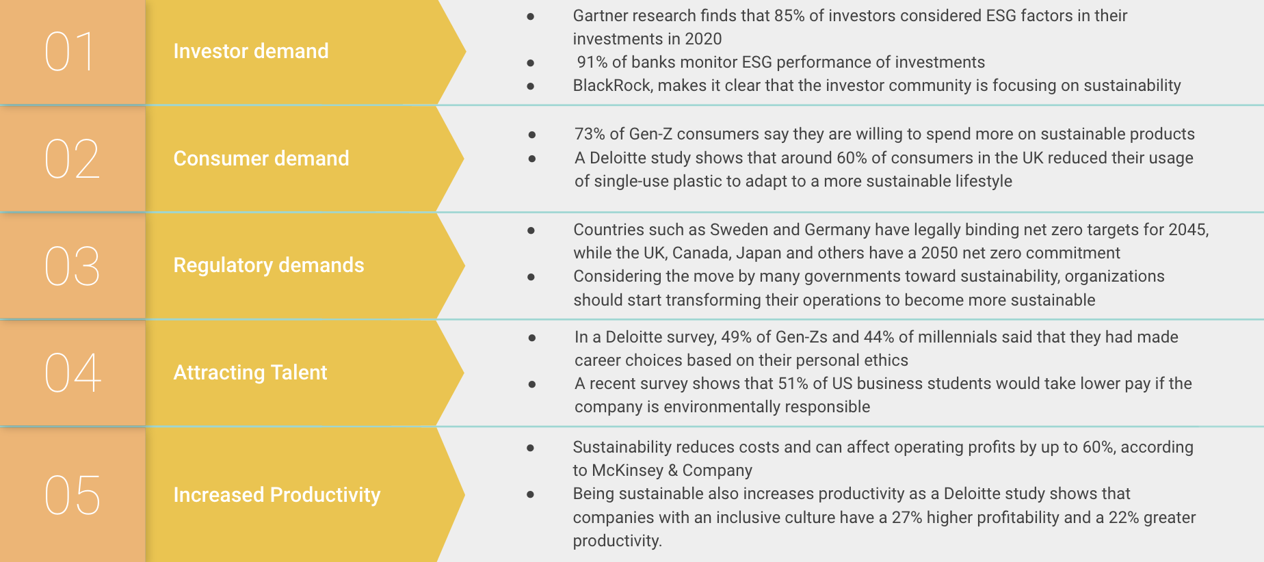
Problem
What data should we check from each company in order to measure the level of attention of that company to the issues surrounding sustainable development?
Why sustainability is crucial for corporate strategy?
https://www.weforum.org/agenda/2022/06/why-sustainability-is-crucial-for-corporate-strategy/
Notes:
Highlight that sustainability has become a top priority in the Netherlands, driven by government policies (e.g., net-zero goals by 2050) and business pressures.Underscore that companies need to showcase their sustainability efforts publicly—and that analyzing these disclosures helps us understand their true commitment.

Slide 4

Challenge vs Opportunity
Dutch companies produce vast amounts of text (websites, annual reports, policy documents).
Manual review to find sustainability references is time-intensive and inconsistent.
Need for a systematic, automated, and scalable approach.
HTML pages
text
PDFs
PDFs
text
HTML pages
text
HTML pages
PDFs
Manually check
Notes:
Highlight that sustainability has become a top priority in the Netherlands, driven by government policies (e.g., net-zero goals by 2050) and business pressures.Underscore that companies need to showcase their sustainability efforts publicly—and that analyzing these disclosures helps us understand their true commitment.

Slide 5
Our Approach
Goals:
Index Dutch Companies based on sustainability.
Extract Keywords that indicate sustainability efforts.
Filter Out Sensitive or Irrelevant Information to stay compliant and focused.
Generate an Actionable Output (dashboards, ranks, and insights).
Automatic NER Filtering
Keyword Extractor
Index Generator
Benefits and Applications:
Benchmarking: Compare sustainability across companies.
Decision-Making: Inform strategic decisions with data-driven insights.
Reporting: Generate detailed sustainability reports
Sustainability Analysis Platform

Slide 6
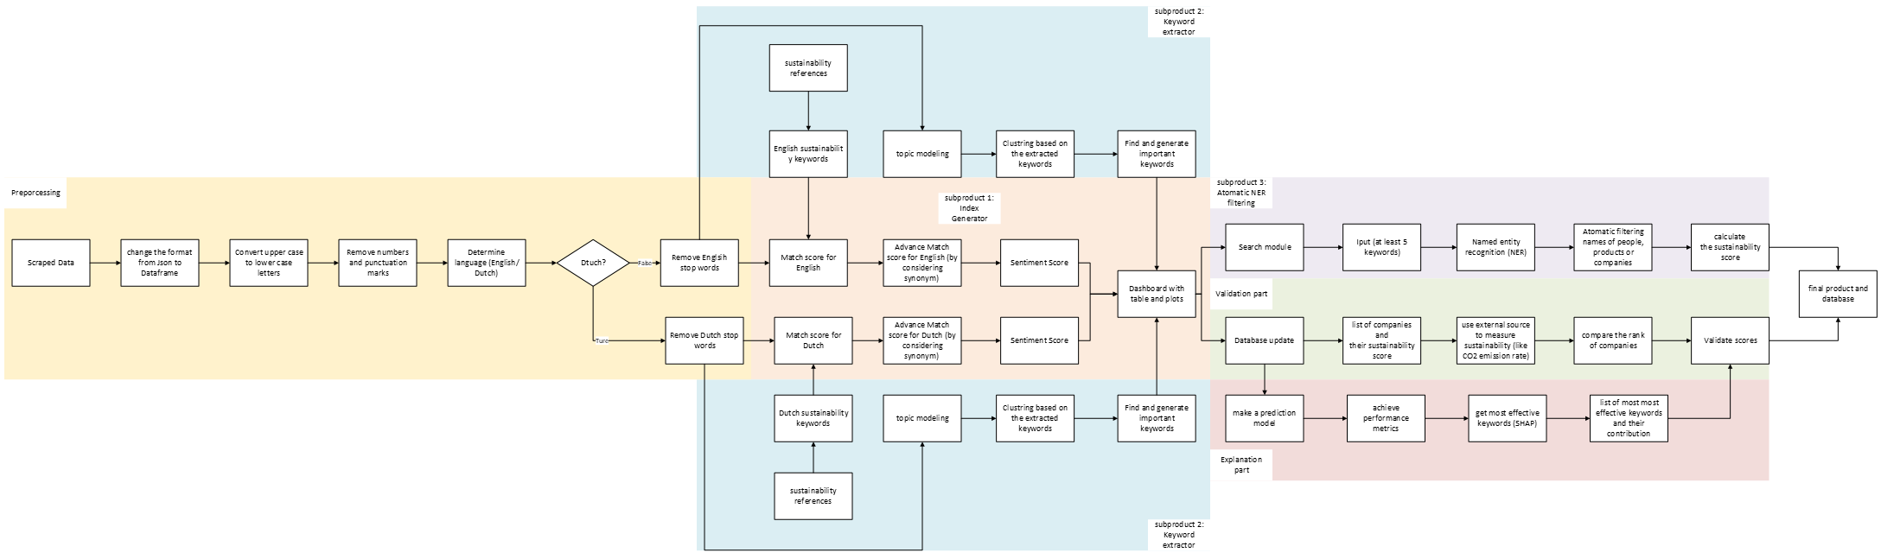
Roadmap
Preprocessing: Clean and normalize text (e.g., remove punctuation/numbers, handle Dutch vs. English).
Subproduct 1 – Index Generator
Subproduct 2 – Keyword Extractor
Subproduct 3 – Automatic NER Filtering
Final Product: A secure database and user-friendly dashboard.
Sustainability Analysis Platform Flow chart

Slide 7
Preprocessing Overview
Data Sources: Scraped data from company websites in JSON format.
Steps: Convert JSON to DataFrame
Convert uppercase to lowercase
Remove numbers and punctuation
Detect language (English or Dutch)
Remove respective stopwords
Scraped data
Clean text
Language detection
Filter stopwords
Ready for analysis
Preprocessing Overview

Slide 8
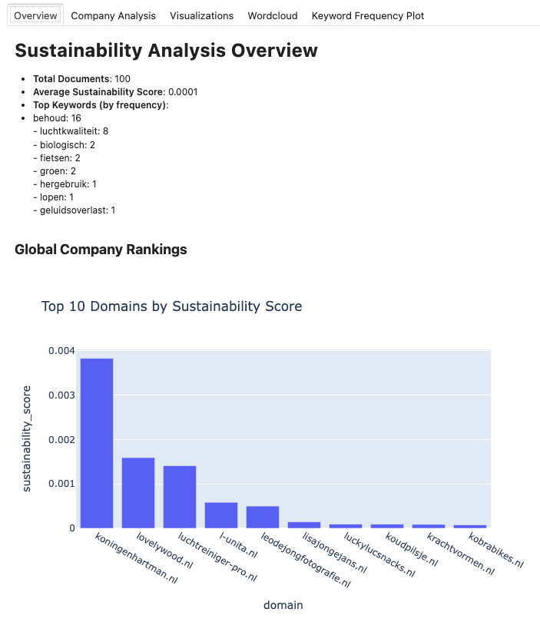
Subproduct 1 - Index Generator
Purpose:
Defines an index that shows how each company considers sustainability.
Functionality:
Keyword Identification: Searches for sustainability-related keywords and synonyms on company websites.
Contextual Analysis: Assesses keyword frequency and relevance.
Index Calculation: Computes a sustainability index score for each company.
Benefits:
Provides a measurable benchmark for sustainability.
Offers objective, data-driven evaluation.
Identifies strengths and areas for improvement in sustainability practices

Slide 9
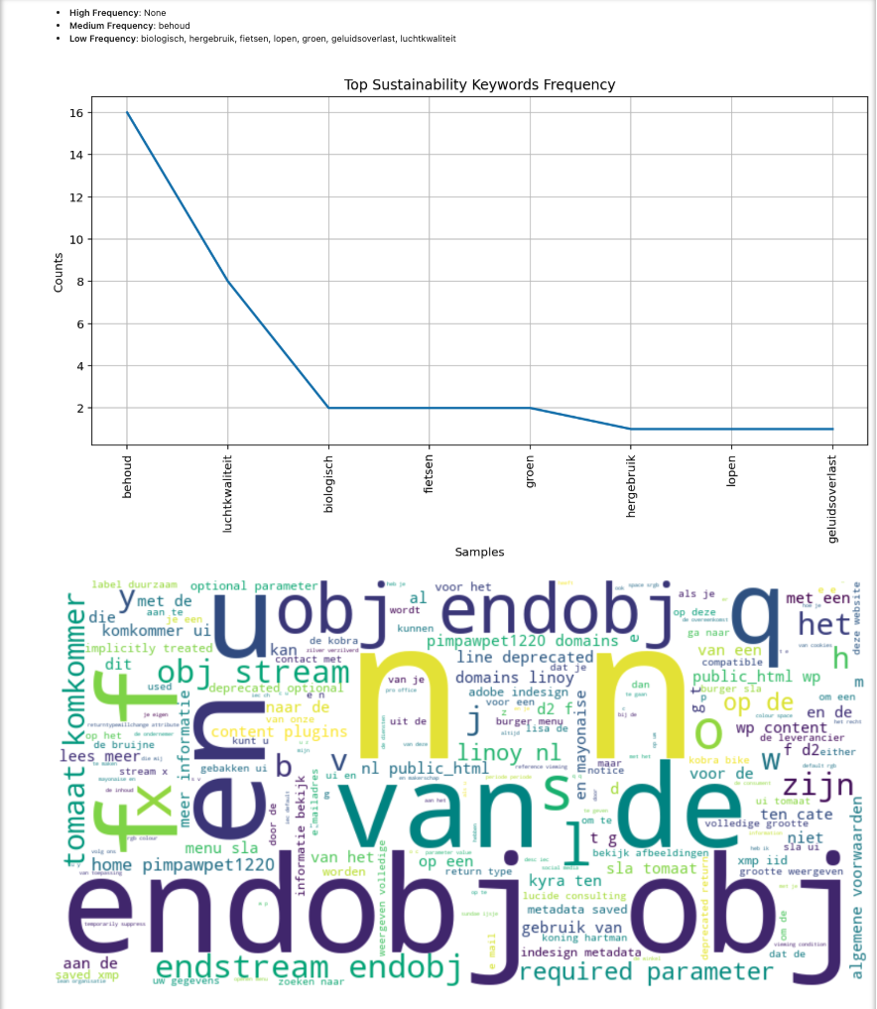
Subproduct 2 - Keyword Extractor
Purpose:
Discovers and analyzes sustainability-related keywords within each company’s domain.
Functionality:
Topic Modelling: Uncovers prevalent topics related to sustainability using LDA.
Clustering Techniques: Groups similar keywords to identify main themes.
Dynamic Keyword Generation: Updates and refines relevant keywords based on new data.
Benefits:
Comprehensive analysis of sustainability terms and themes.
Provides deep, data-driven insights.
Customizable exploration of specific sustainability themes.

Slide 10
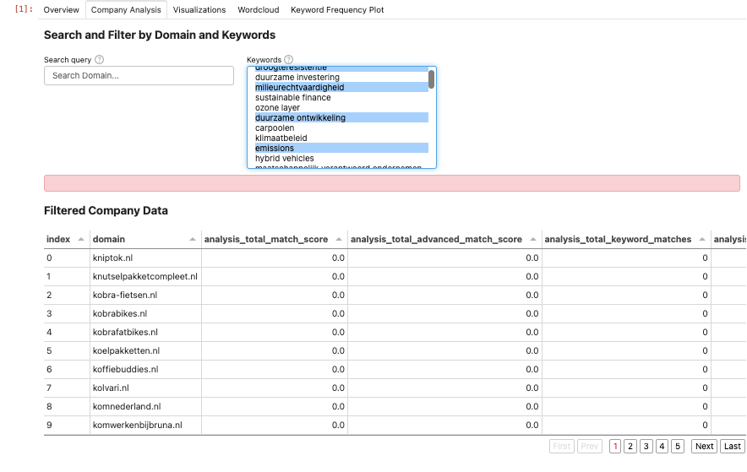
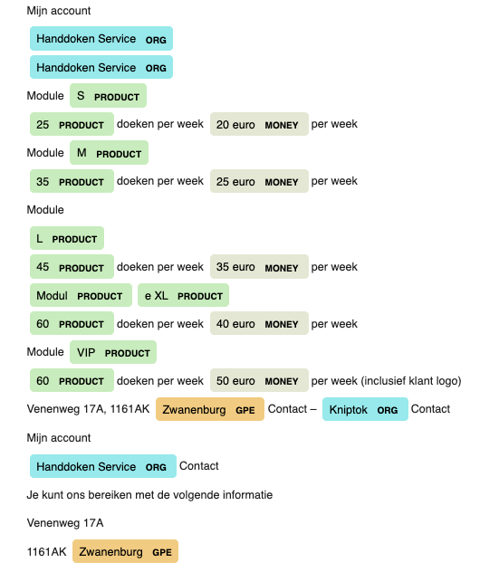
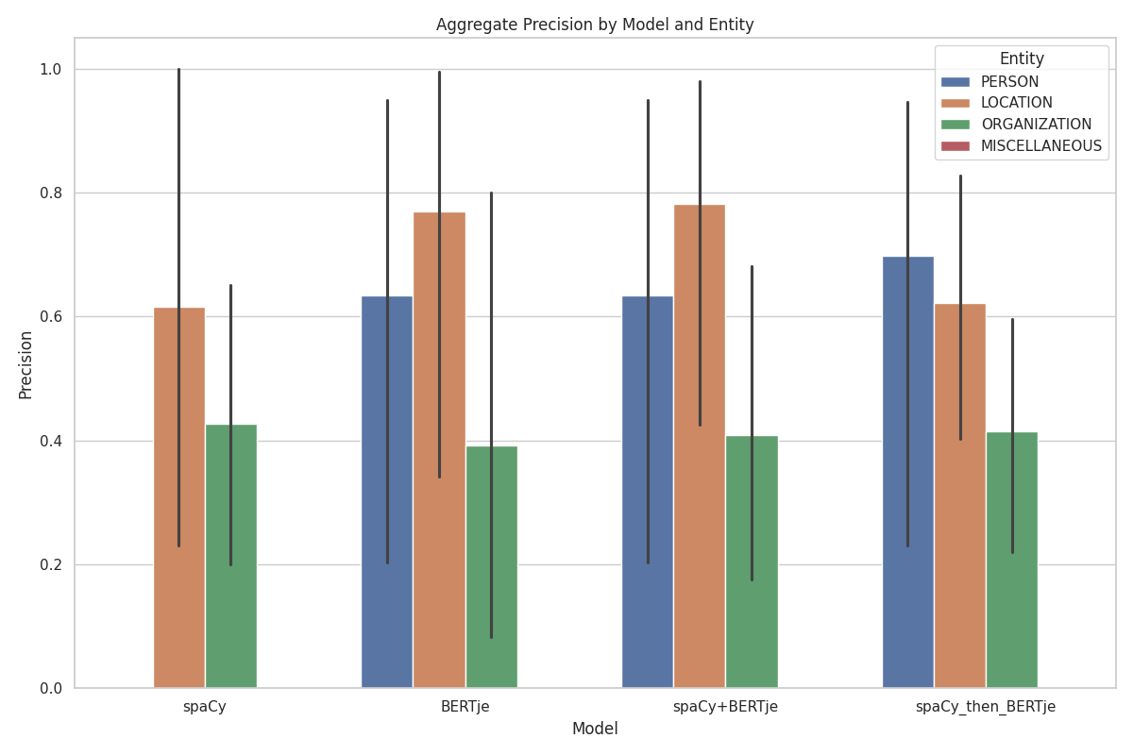
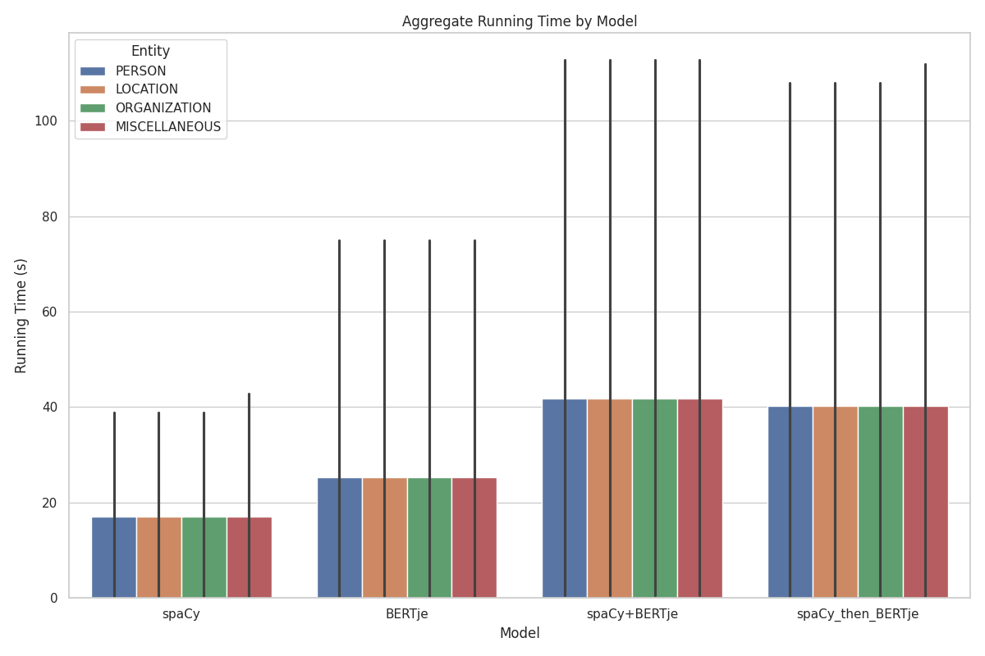
Subproduct 3 - Automatic NER Filtering
Purpose:
Removes non-relevant information, company names, and personal identities to guarantee the integrity and relevancy of user searches.
Functionality:
NER Filtering: Uses Spacy/BERTje to automatically filter out non-relevant entities.
Keyword Optimization: Determines optimal keyword count for accurate analysis.
Benefits:
Maintains quality and relevance of data analysis.
Simplifies user experience with guided input requirements.
Protects personal and sensitive information.

Slide 11
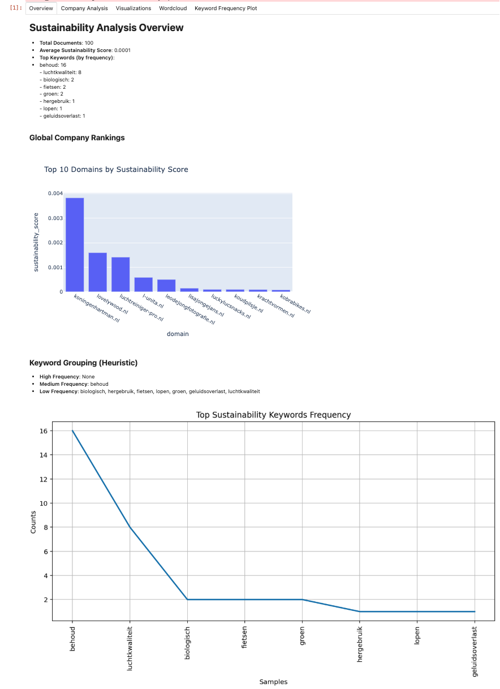
Final Product – Dashboard & Database
Purpose:
The pipeline outputs a structured database with:
Sustainability score for each company.
Keyword frequency
NER-filtered text.
Visualizations (plotly charts, keyword frequency plots, sentiment distribution).
Benefits:
Benchmarking: Compare sustainability across different companies.
Decision-Making: Use data-driven insights for strategic planning.
Reporting: Generate comprehensive sustainability reports (for internal or external stakeholders).

Slide 12

Future Improvements & Next Steps
Evaluating with Additional External Data: Incorporate datasets such as water usage statistics and other environmental metrics for broader analysis.
Enhancing NLP Models: Use advanced transformer-based architectures to improve model performance.
Applying Explainable AI (XAI) Techniques: Identify which parts of the text contribute most to the outcomes.
Developing Methods for Broader Application: Adapt the approaches for analyzing similar types of reports.

Slide 13

Discussion – What Output Do You Need?
Some Questions:
Q1: Do you prefer a ranking of companies, or do you also want in-depth text analysis?
Q2: Which external metrics matter most to you (CO2, social impact, etc.)?
Q3: Would you use an interactive dashboard or do you prefer standard PDF reports?
Q4: How else can we integrate with your research or systems?
More Suggestions?

Slide 14
Thank You!
For further questions or details, please contact:
h.mohammadi@uu.nl

