Slide 1
Master Data Management
January 14, 2025
Peter Gerbrands, Wolter Hassink, Daniel Oberski,
Rutger Schilpzand, Arjen van Witteloostuijn

Slide 2
Master Data Management (MDM)
“Master Data Management (MDM) is the framework of processes and technologies aimed at creating and maintaining an authoritative, reliable, sustainable, accurate and secure data environment that represents a ̒single version of truth,̕ an accepted system of record used both intra- and interenterprise across a diverse set of application systems, lines of business, and user communities”
A. Berson and L. Dubov, Master Data Management and Customer Data Integration for a Global Enterprise, Mcgraw-Hill, 2007.

Slide 3
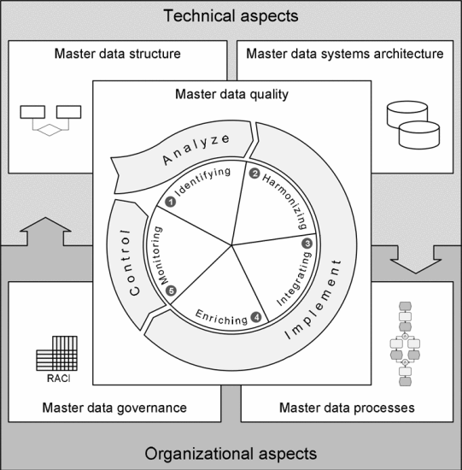






Master Data Management (MDM)
Master data structure is organized around bronze, silver and gold data definitions and data definitions.
Systems architecture is realized through SURF Object Store, SURF SANE, ODISSEI Data Portal
Master data processes are realized in Python and Apache Spark.
Master data governance will be realized through SURF SRAM/SANE and human (review) processes.
A. Cleven and F. Wortmann, "Uncovering Four Strategies to Approach Master Data Management," 2010 43rd Hawaii International Conference on System Sciences, Honolulu, HI, USA, 2010, pp. 1-10, doi: 10.1109/HICSS.2010.488.

Slide 4
Who is the Master?
One list to rule them all: Each company and establishment gets its own unchangeable identifier which is used in all data sets.
KVK: [1] "Faculteit Diergeneeskunde, Willem C. Schimmelgebouw“, [2] "Faculteit Diergeneeskunde, Jeanette Donker-Voetgebouw“, [3] "Faculteit Diergeneeskunde, Prof. dr. H. Jakobgebouw“, [4] "Faculteit Geneeskunde“, [5] "Faculteit Diergeneeskunde, Boerderij De Tolakker“, [6] "Parnassos Cultuurcentrum“, [7] "Faculteit Diergeneeskunde, Jeanette Donker-Voetgebouw“, [8] "Faculteit Diergeneeskunde, Prof. dr. H. Jakobgebouw“, [9] "Faculteit Diergeneeskunde, Nieuw Gildestein - Gemeenschappelijk Dierenlaboratorium“, [10] "Faculteit Bètawetenschappen, Hugo R. Kruytgebouw“, [11] "Faculteit Bètawetenschappen, David de Wiedgebouw“, [12] "Faculteit Diergeneeskunde, Nieuw Gildestein - Gemeenschappelijk Dierenlaboratorium“, [13] "Universiteit Utrecht“, [14] "Faculteit Bètawetenschappen“, [15] "Faculteit Sociale Wetenschappen“, [16] "Faculteit Diergeneeskunde“, [17] "Faculteit Geesteswetenschappen“, [18] "Faculteit Geowetenschappen“, [19] "Universiteitsbibliotheek“, [20] "Faculteit Bètawetenschappen, Kassencomplex Harvardlaan“, [21] "Faculteit Recht, Economie, Bestuur en Organisatie“, [22] "Faculteit Bètawetenschappen, Nicolaas Bloembergengebouw“, [23] "Faculteit Diergeneeskunde, Willem C. Schimmelgebouw“, [24] "Faculteit Diergeneeskunde, Androclusgebouw“, [25] "Faculteit Geowetenschappen, Vening Meineszgebouw B“, [26] "Faculteit Diergeneeskunde, Androclusgebouw“
LISA: [1] UU UBU Universiteitsbibliotheek Utrecht, [2] UU GDL-Gemeenschappelijk Dierenlaboratorium, [3] UU Fac. Diergeneeskunde, [4] UU Fac. Geesteswetenschappen bureau, [5] UU UBD Universitaire Bestuursdienst, [6] Faculteit Geneeskunde UMC Utrecht, [7] UU Fac. Betawetenschappen Dep. Wiskunde, [8] UU Fac. Sociale Wetenschappen, [9] UU Fac. Geowetenschappen, [10] Parnassos Cultuurcentrum

Slide 5
What Changed?
Companies and their establishments change:
  They relocate elsewhere (change of address)
  They start new activities (change in SBI code)
  They change corporate structure (change of legal form)
  They re-brand themselves (change of name)
  They are sold (change of ownership)
So how will we keep the establishment history?

Slide 6
What Changed?
New shop: 400, or did shop 100 relocate?
ID | Name | Street | SBI Code | Owner
100 | Big Shop | Oudegracht 1 | 123 | BIG
200 | Big Shop | Keizerstraat 2 | 123 | BIG
300 | Small Shop | Markt 3 | 321 | SMALL
? | Big Shop | Plein 4 | 123 | BIG
? | Small Shop | Oudegracht 1 | 321 | BIG
? | Small Shop | Oudegracht 1 | 123 | SMALL
? | Big Shop Admin | Plein 4 | 456 | BIG
? | Big Shop Admin | Oudegracht 1 | 123 | BIG
? | Big Shop | Keizerstraat 2 | 123 | SMALL

Slide 7
What Changed?
Was 300 taken over by BIG (no change of address and SBI?
ID | Name | Street | SBI Code | Owner
100 | Big Shop | Oudegracht 1 | 123 | BIG
200 | Big Shop | Keizerstraat 2 | 123 | BIG
300 | Small Shop | Markt 3 | 321 | SMALL
? | Big Shop | Plein 4 | 123 | BIG
? | Small Shop | Oudegracht 1 | 321 | BIG
? | Small Shop | Oudegracht 1 | 123 | SMALL
? | Big Shop Admin | Plein 4 | 456 | BIG
? | Big Shop Admin | Oudegracht 1 | 123 | BIG
? | Big Shop | Keizerstraat 2 | 123 | SMALL

Slide 8
What Changed?
ID | Name | Street | SBI Code | Owner
100 | Big Shop | Oudegracht 1 | 123 | BIG
200 | Big Shop | Keizerstraat 2 | 123 | BIG
300 | Small Shop | Markt 3 | 321 | SMALL
? | Big Shop | Plein 4 | 123 | BIG
? | Small Shop | Oudegracht 1 | 321 | BIG
? | Small Shop | Oudegracht 1 | 123 | SMALL
? | Big Shop Admin | Plein 4 | 456 | BIG
? | Big Shop Admin | Oudegracht 1 | 123 | BIG
? | Big Shop | Keizerstraat 2 | 123 | SMALL
Did 300 change address and SBI, so new shop?

Slide 9
What Changed?
ID | Name | Street | SBI Code | Owner
100 | Big Shop | Oudegracht 1 | 123 | BIG
200 | Big Shop | Keizerstraat 2 | 123 | BIG
300 | Small Shop | Markt 3 | 321 | SMALL
? | Big Shop | Plein 4 | 123 | BIG
? | Small Shop | Oudegracht 1 | 321 | BIG
? | Small Shop | Oudegracht 1 | 123 | SMALL
? | Big Shop Admin | Plein 4 | 456 | BIG
? | Big Shop Admin | Oudegracht 1 | 123 | BIG
? | Big Shop | Keizerstraat 2 | 123 | SMALL
New name
or new store?

Slide 10
Identification Requirements
Find all establishments that belong to a company.
Track evolution of specific establishment over time.
Link 3rd party data to the right establishment and company.
Track historical events in the data but also in the database.

Slide 11
Identification Approach
fbb_grp_id: Company / Group / Corporation
fbb_est_id: Establishment / Branch / Location (according to KVK the establishment only changes when both the address and the SBI code change simultaneously)
fbb_id: Default unit of analysis (unique per company and establishment combination).

Slide 12
Supporting Information
fbb_wave_id: Date of the snapshot used to update the record
fbb_source: Source of record (e.g. when merging different sources)
fbb_file_id: Keep copy of the raw file with this ID in the filename
fbb_row_id: Unique per data row, needed for checking merge
fbb_updated: Date when the record was added to the backbone
fbb_deleted: Date when a new version of the record replaced it

Slide 13

Other Requirements
HOW will you use the data?
  Stock and/or flow data?
  Full history or snapshot?
  Duplicate data or deltas only?
HOW to deal with corrections?
  Change retrospectively (reproducibility?)
  Add new records (event that didn’t happen?)
WHAT will you use?
  Specific legal forms only (e.g. only LLC, no churches)?
  Only companies located in a specific region?
  All companies with similar activities (SBI)?
WHEN do we update data?
  KVK: January and July
  SIDN: January and July
  LISA: March

Slide 14
Data Governance & Support
Access Management
Contract Management
Data Protection
User Guides
(Best Practices)
User Support
(IT & Usage)
User Access Controls (SRAM)
Data Ingestion
(Bronze)
Data Processing
(Silver)
Data Provisioning
(Gold)
Data Analysis
(SANE)
Data Retrieval
(File, Web, …)
Data Conversion
(File Format)
Data Pseudonymization
Data Access
Data Storage
(Permanent)
Data Linking
(Identities)
Data Cleaning
Data Tinkering
Data Staging
(Temporal)
Data Extraction
(Text Mining)
Data Aggregation
Blind Analysis
Metadata Extraction
Metadata
Enrichment
Metadata
Querying
Data Lineage
Servers, Networks & Security
Metadata Management
Infra. Management

Slide 15
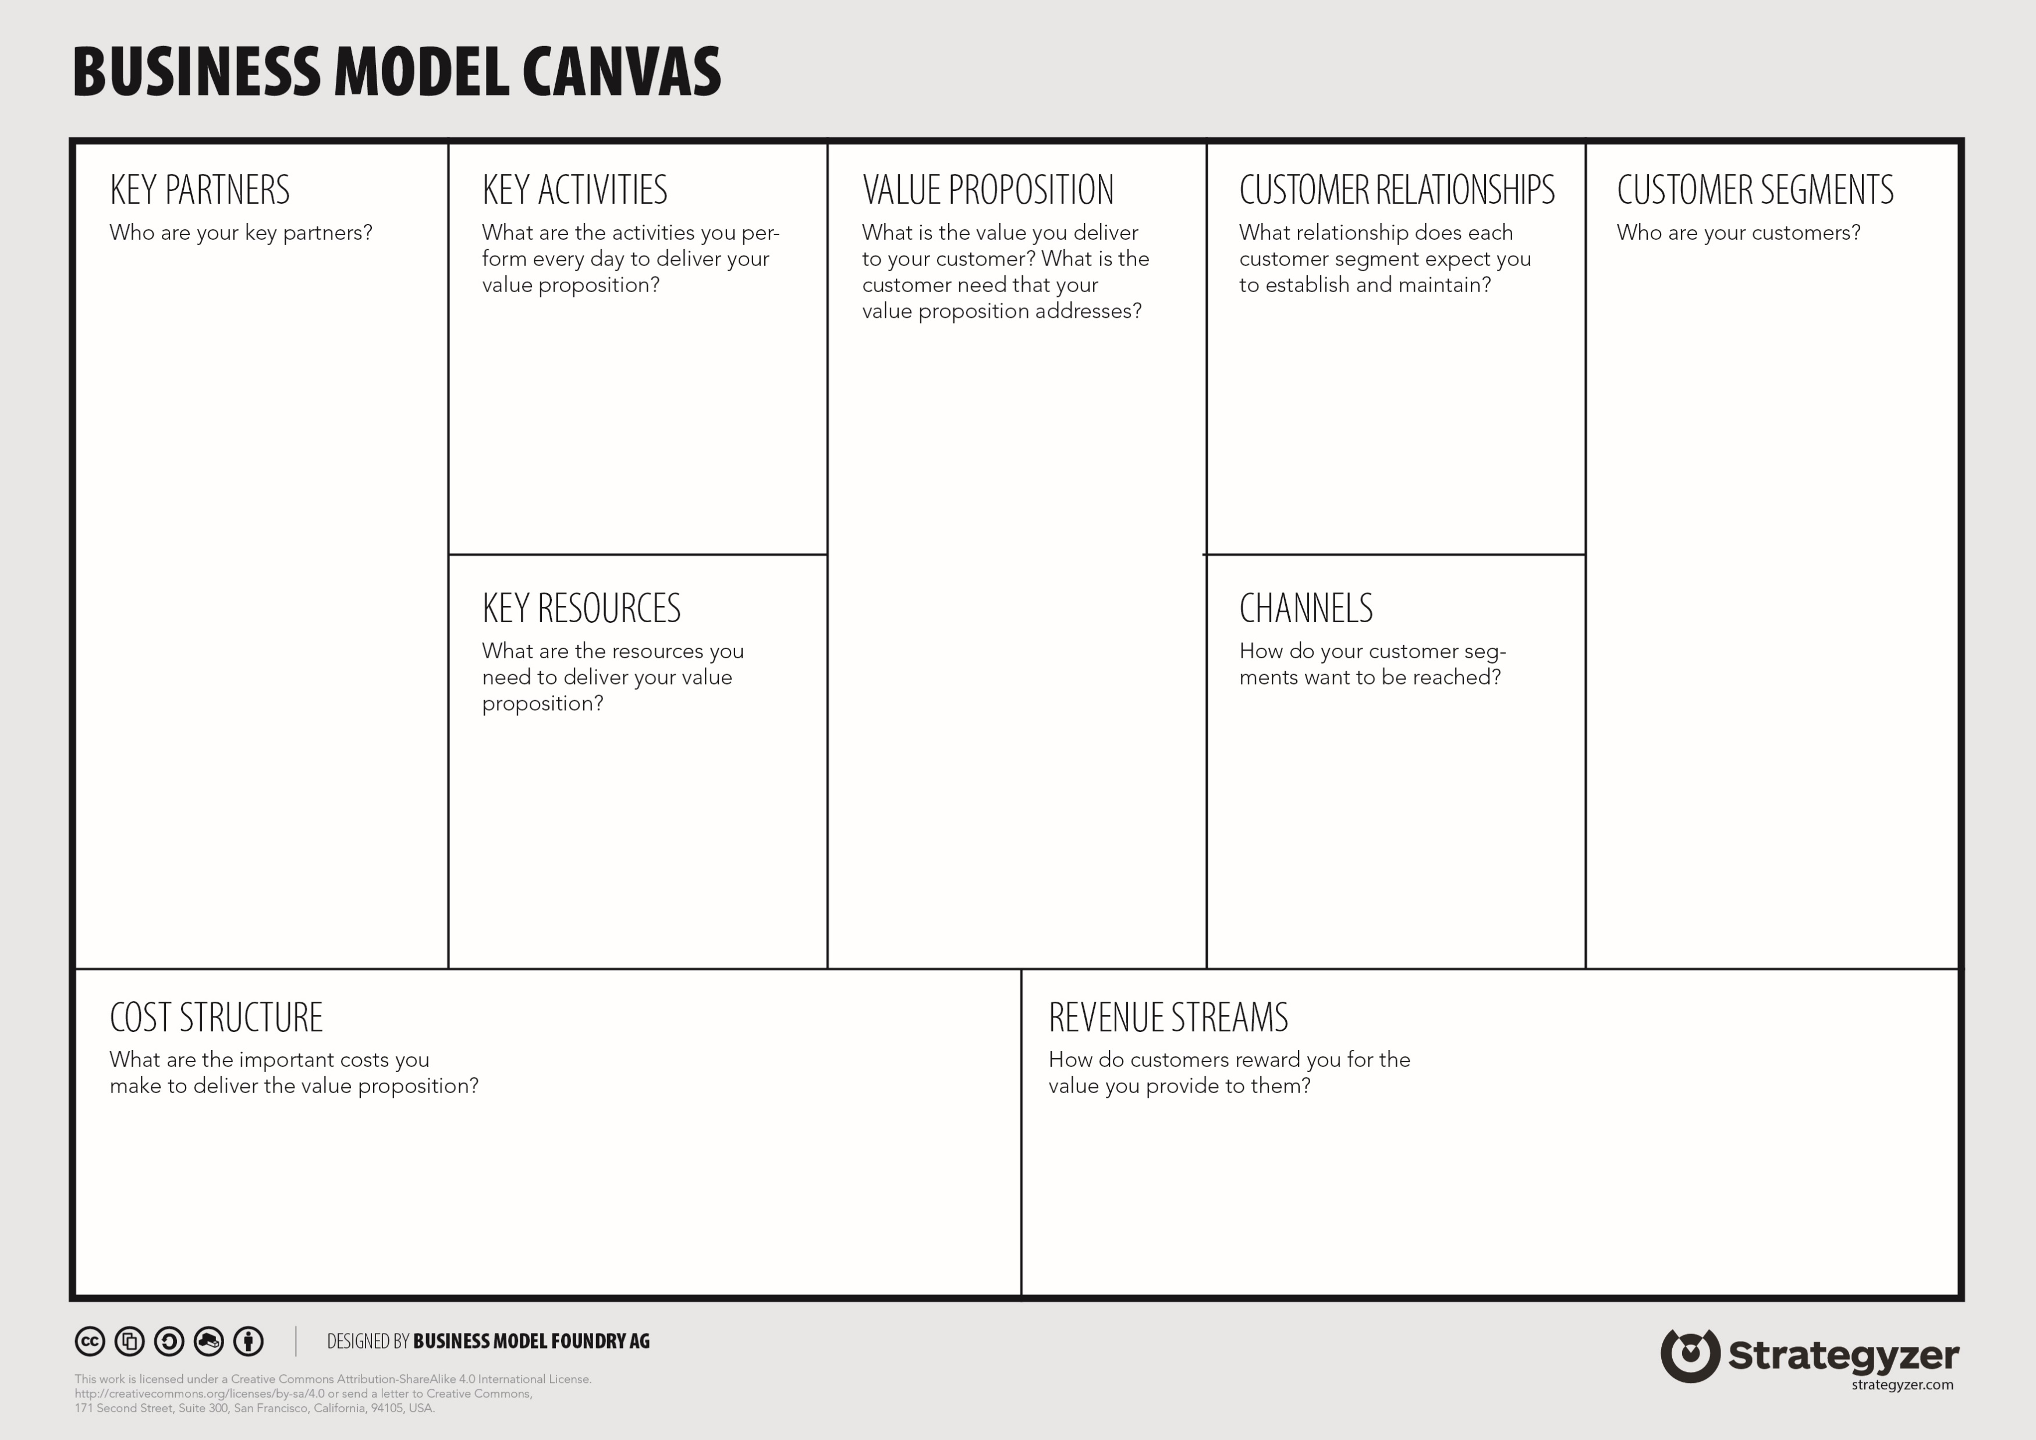




FIRMBACKBONE
Data Processing
Data Persistence
Data Provisioning
Data Contributor
Data Ingestion
Data Access
University Researcher
Data Consumer
Strategic Partners
Customer Support
Data Governance
KVK
Enriched Data
Time series Data
University Students
Linked Data
PDF/Text Miner
Low-level Data
Strategic Providers
SANE
Big-Data Analysis
SURF
Platform
Data Storage
University Platforms
Metadata Portal
Reducing Costs
Societal Contrib.
Stewards Network
KVK
Web Scraper
ETL Pipeline
Server Hosting
Engineers Team
Storage Space
Compute Costs
Future Grants
University Faculties
Admin Team

