Slide 1




Open-science principles and restricted data Peter Gerbrands, Wolter Hassink, Daniel Oberski, Rutger Schilpzand, Arjen van Witteloostuijn
Infrastructure Kick-off
15 January 2026
Notes:
I would like to talk about how to market the data, but at the same time make datasets reliable and more impactful. While improving visibility and popularity you also increase the reliability of your data, and attract feedback from users. In the end the aim is for researchers to get reliable experience of the data

Slide 2
Motivation for the Infrastructure Kick-off
Inform and discuss (ongoing) projects with firm data researchers
Celebrate the permanent character and VU-UU collaboration

Slide 3
Legal issues
Time | Who | What
13:45-14:00 | everyone | Walk-in (coffee/tea)
14:00-14:15 | Wolter Hassink (UU) | Introduction: What is FIRMBACKBONE? [link]
14:15-14:35 | Erik-Jan van Kesteren & Thom Volker (UU) | Synthetic data application [link]
14:35-14:55 | Jack Fitzgerald (VU) | Which Businesses Answer Surveys? Evidence from Dutch Administrative Data. [link]
14:55-15:15 | Lucas van der Meer (ODISSEI) | FAIRer access through the Data Access Broker [link]
15:15-15:35 | Sasa Batistič & Nuno Barros De Oliveira (TiU) | TiCCODA [link] planning firm surveys in Noord-Brabant*
15:35-15:50 | Simon Huijben (UU) | The economic geography of impact first companies [link] in the Netherlands
15:50-16:00 | Arjen van Witteloostuijn (VU) & Elaine Mak (UU) | Signing partnership agreement
16:00-17:00 | everyone | Drinks!

Slide 4
About the infrastructure
Since end 2025 it receives permanent funding
access, support and expansion of the databases and infrastructure will be continuous

Slide 5














Aims (I)
Be an intermediary party for data providers and the SSH community for data on all Dutch organisations with a legal status
Based on the concept of open-science for sensitive data (through ODISSEI)
Intended users of the data: students and researchers at the Dutch universities
Dataproviders: KVK, LISA, SIDN, researchers

Slide 6
Aims (II)
Access by users is authorized by FBB according to strict procedures
Access to pseudonymized data of firms and their establishments based on the “KVK Handelsregister”
Applications for broad disciplines within the social sciences
Provide information on employees, economic sector, location, financial statements, website texts
Possibility to add own data relevant to firms for research
Ensure organic growth of information
Provide FAIR data

Slide 7
Old situation
Detailed company information available for research
Commercial companies from the US offer up-to-date data
High costs for universities, where public money disappears abroad Dependent on foreign data providers
Individual researcher applications to the Chamber of Commerce
Time-consuming for KVK and researchers,
Individual data per project, not reproducible
Request for CBS-micro data
High costs (legal requirements, financial) per research project
Consequence
Limited ability to analyse the Dutch firm landscape at universities

Slide 8
New situation
FBB intermediary between providers and researchers
A source of information for researchers and data providers
Creates a dialogue and strengthens knowledge
Linked data and expandable (organic growth)
FAIR -> reproducible and can be used for more projects (by other researchers)
Safe
Shielded analysis environment Completely pseudonymized and stripped of personal data

Slide 9
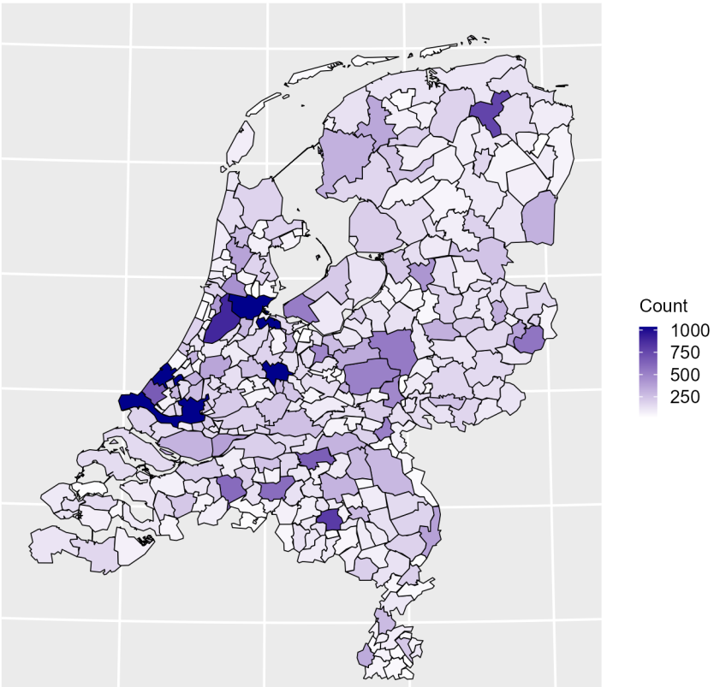
The data
Over 1 million organisations
Over 4 million establishments
Administrative data
2023 Q4; 2024 Q1; 2025 Q1*; 2025 Q4*
Employment data
2019; 2020; 2021; 2022; 2023*
Webscraped data
2024 Q2*; 2025 Q3*
* available in 2026
Example: Number of headquarters per region for 10+ employee organisations

Slide 10
Legal issues
Time | Who | What
13:45-14:00 | everyone | Walk-in (coffee/tea)
14:00-14:15 | Wolter Hassink (UU) | Introduction: What is FIRMBACKBONE? [link]
14:15-14:35 | Erik-Jan van Kesteren & Thom Volker (UU) | Synthetic data application [link]
14:35-14:55 | Jack Fitzgerald (VU) | Which Businesses Answer Surveys? Evidence from Dutch Administrative Data. [link]
14:55-15:15 | Lucas van der Meer (ODISSEI) | FAIRer access through the Data Access Broker [link]
15:15-15:35 | Sasa Batistič & Nuno Barros De Oliveira (TiU) | TiCCODA [link] planning firm surveys in Noord-Brabant*
15:35-15:50 | Simon Huijben (UU) | The economic geography of impact first companies [link] in the Netherlands
15:50-16:00 | Arjen van Witteloostuijn (VU) & Elaine Mak (UU) | Signing partnership agreement
16:00-17:00 | everyone | Drinks!

