Slide 1



Synthetic data for FIRMBACKBONE
A secure solution for data access problems
Thom Volker^{1,2} & Erik-Jan van Kesteren^{1,3}
¹Utrecht University; ²Statistics Netherlands; ³ODISSEI SoDa Team

Slide 2




Team
Thom Volker
Erik-Jan van Kesteren
Peter Gerbrands
Raoul Schram

Slide 3
FIRMBACKBONE

Slide 4
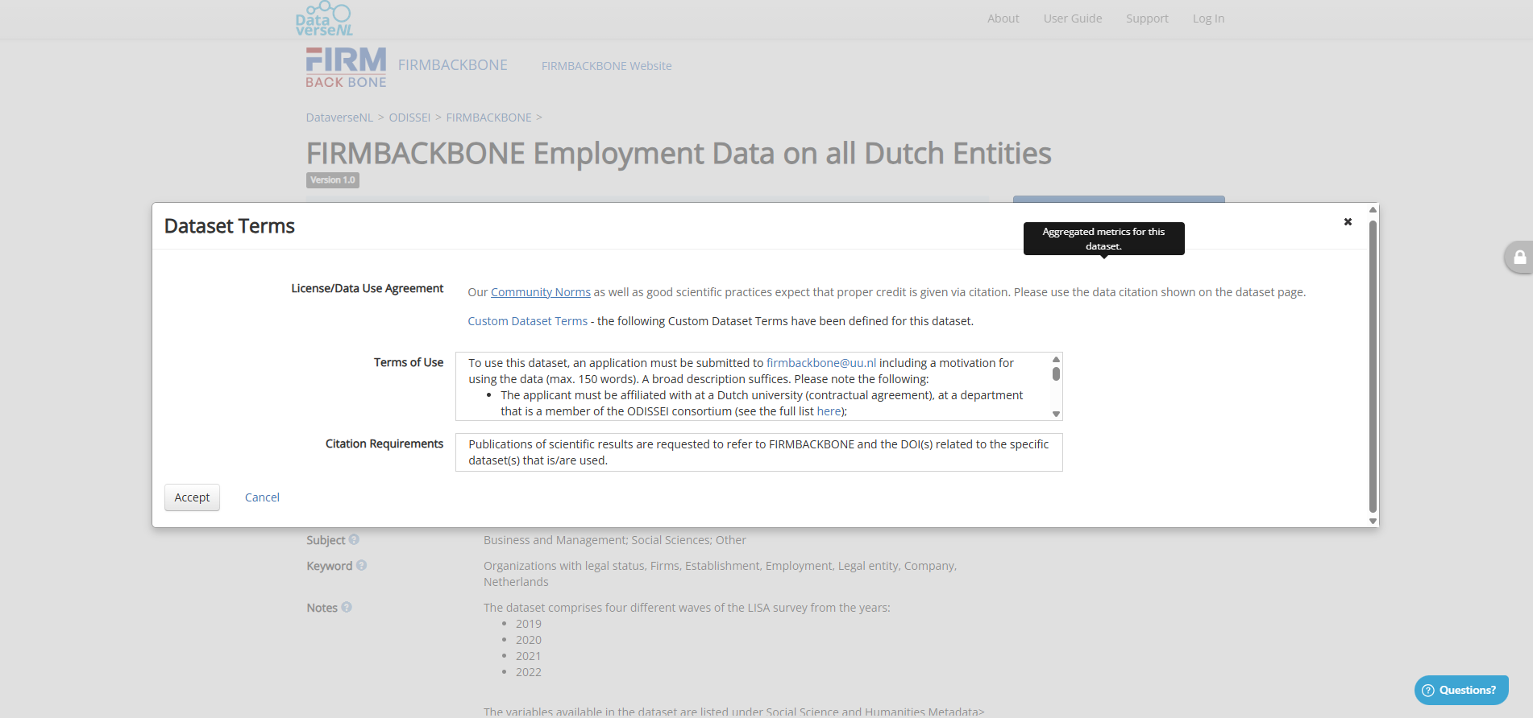

Slide 5
Data access management is good! … but can also be annoying

Slide 6
Synthetic data
Synthetic data is generated from a model
As opposed to real, natural, collected data
fake data
generated data
simulated data
digital twin
public use file

Slide 7
Synthetic data generation

Slide 8
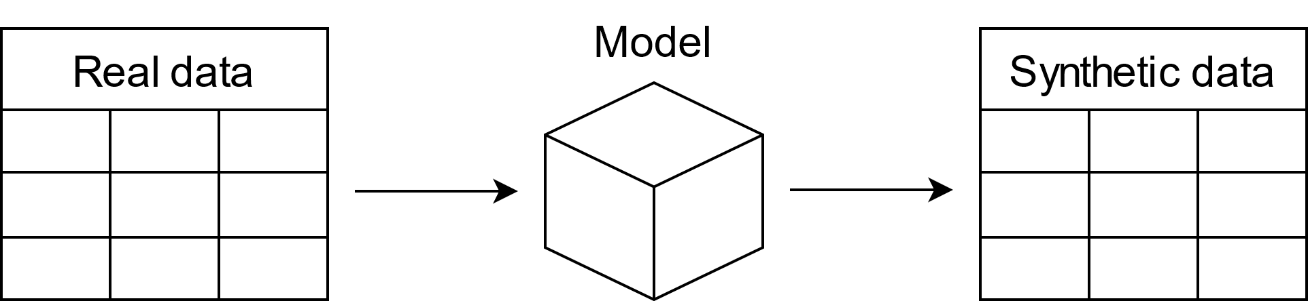
Generating synthetic data

Slide 9
Privacy – fidelity tradeoff
Every parameter in the data-generating model contains information about the observations in the real data
The more complex your model (e.g., many parameters), the closer the synthetic data will be to the true data: “fidelity”

Slide 10
What can we do with the synthetic data?
Investigate & answer all your research questions
Getting to know the data
Use the data as a toy example
Develop & validate data analysis scripts and pipelines -> code-to-data
Find out how much your colleagues earn
Basic correlation analysis
Anything you can do with real data
Nothing
Fidelity
Visualisation of association
Privacy
Visualisation of variation
Estimate parameters with low simulation error

Slide 11

The solution
Step 1: make the model simple and transparent
No multivariate information (!) just a simple model for each variable
You (yes you!) can inspect the model through metadata
Step 2: allow for automatic disclosure control rules
Today: Eurostat / CBS disclosure control rules
Easy-to-implement plugin system: every org. their own rules!

Slide 12
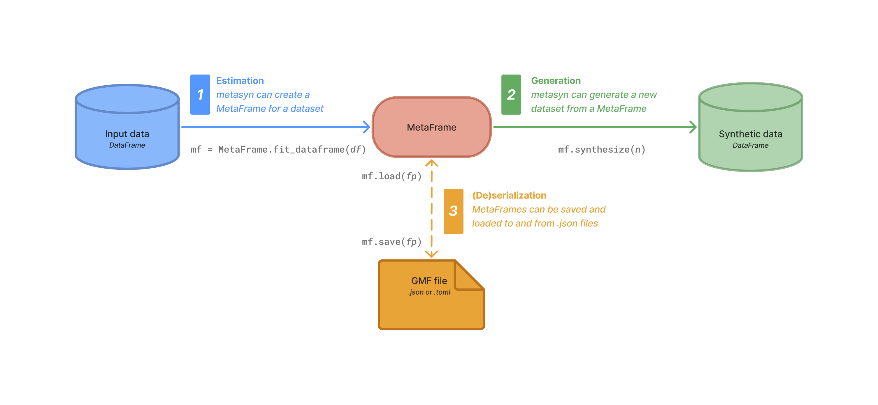
python package
https://github.com/sodascience/metasyn

Slide 13
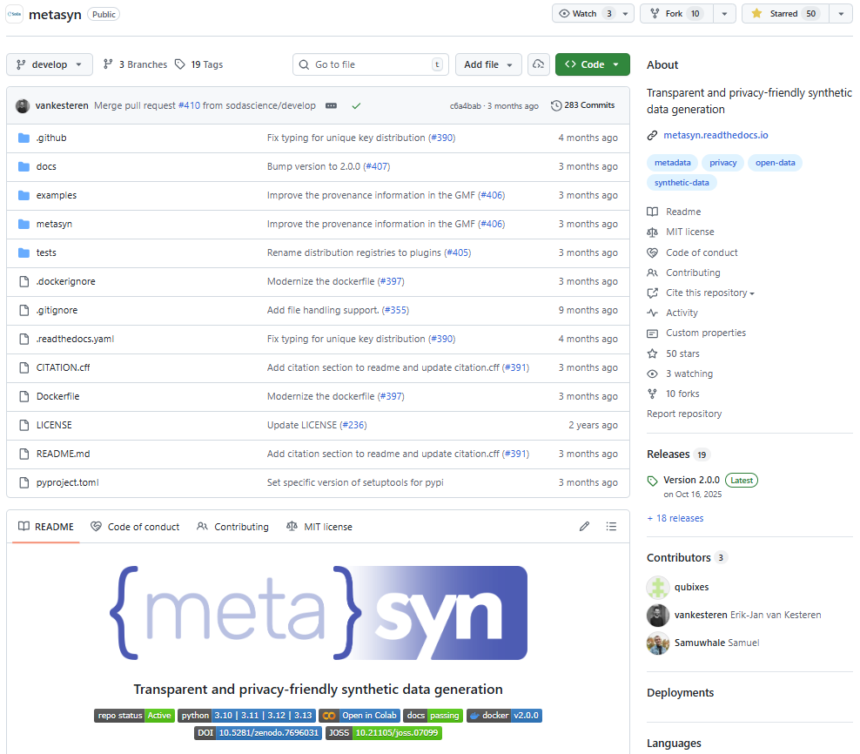
github.com/sodascience/metasyn

Slide 14
TDCC-SSH: Synthetic data
Enabling the potential of synthetic data in the social and health sciences
Funded by NWO
https://tdcc-synthetic-data.nl/

Slide 15
https://tdcc-synthetic-data.nl/

Slide 16
Questions?
t.b.volker@uu.nl

