Slide 1
The Geography of Social Firms
Simon Huijben – PhD candidate UU
s.w.a.a.huijben@uu.nl
FIRMBACKBONE kick-off 15-11

Slide 2
Geography of firms
Economic activity is unevenly distributed across space (Combes & Overman, 2004; Ghosh et al., 2010)
Why? Studied by:
  Economists (Fujita & Thisse, 1996)
  Geographers (Hall, 2006)
  Entrepreneurship scholars (Stam, 2007; Díaz-Foncea & Marcuello, 2015)

Slide 3
What about social firms?
‘Social firms’
  Ambivalent but widely studied (Predo & McLean, 2006; Bacq & Janssen, 2011)
Where do these social firms come from?
  Institutional voids (Stephan et al., 2015)
  Institutional supports (Scott, 1995; 2014)
Hypothesis
  Social impact firms exhibit a different spatial distribution
  Service driven vs product driven social firms exhibit a different spatial distribution

Slide 4
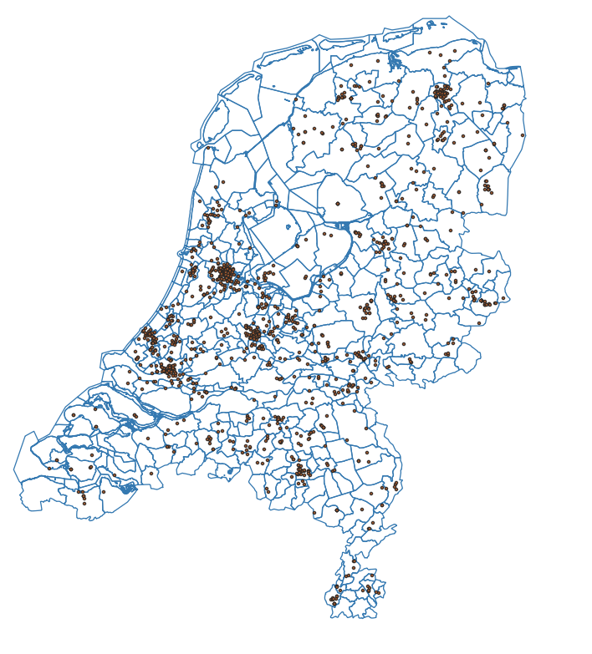
Data
Social firms operationalized as ‘impact first’ (N= 1300)
Data:
  Machine learning (together with Innovatiespotter)
    Entirely checked by a human
  FIRMBACKBONE
  CBS neighborhood

Slide 5
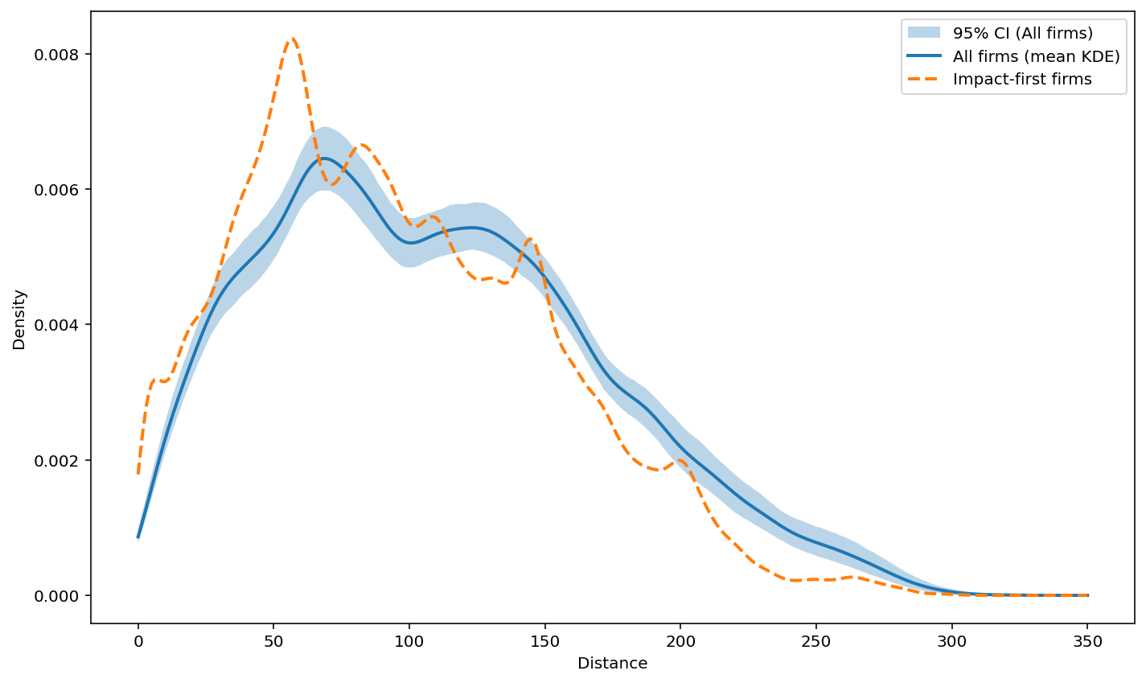
Very preliminary results
Different spatial distribution
  Necessarily sums to one
SF concentrated in:
  Urban areas
  Work-age populations
  High SES

Slide 6
Path forward
Alternative definitions of SFs
Distinguish between service and product focused SE
Robust empirical specifications

Slide 8

Signing moment: partnership agreement VU-UU
Dean SBE - VU: Arjen van Witteloostuijn
Dean REBO - UU: Elaine Mak

